Slide 1
DSC640 Milestone 5 Final Submission
By: Cory Golladay
5/31/2025

Slide 2
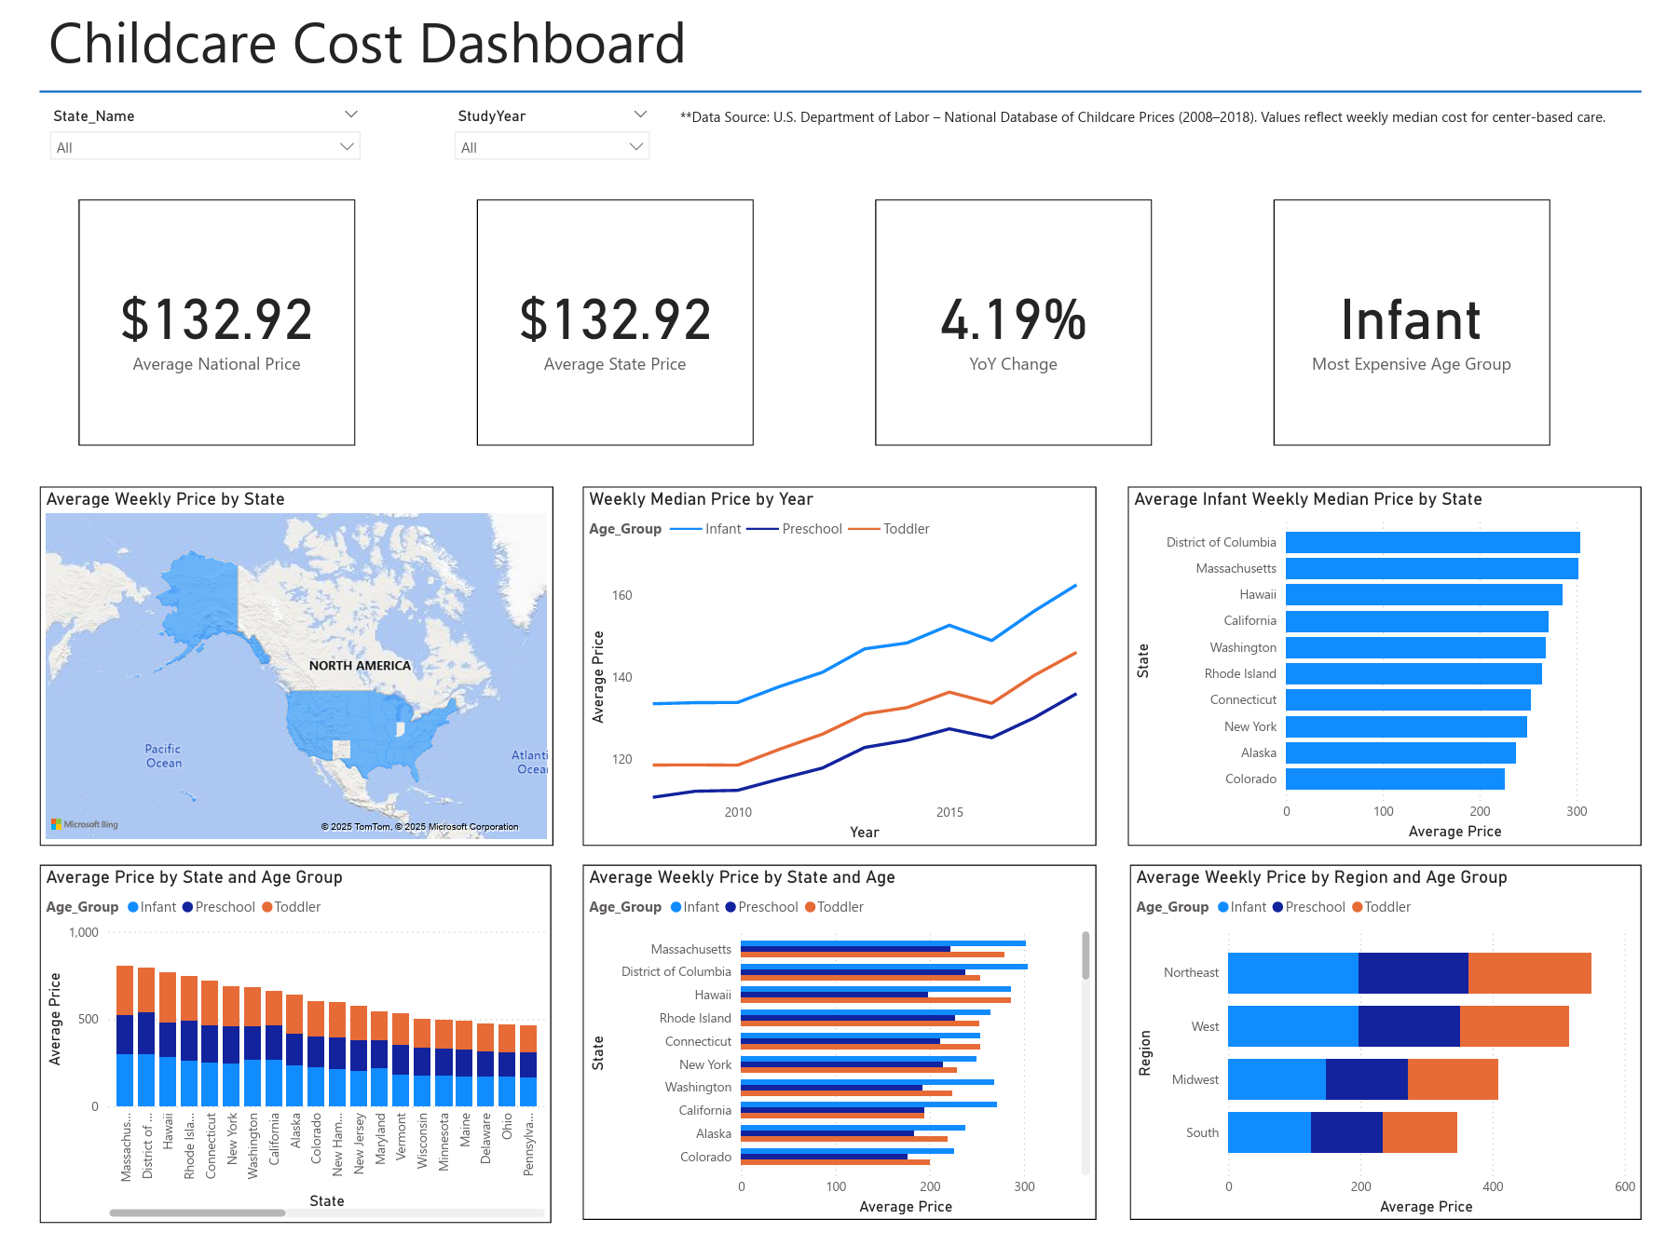
Medium 1: Power BI Dashboard
The dashboard is designed for policy analysts and community stakeholders who want to explore the data dynamically. Users can filter by year and state, to compare weekly childcare costs and trends. The dashboard includes line charts to show trends over time, a map for state-level cost comparison, and bar charts highlighting the most expensive states by age group as planned in my storyboard.

Slide 3
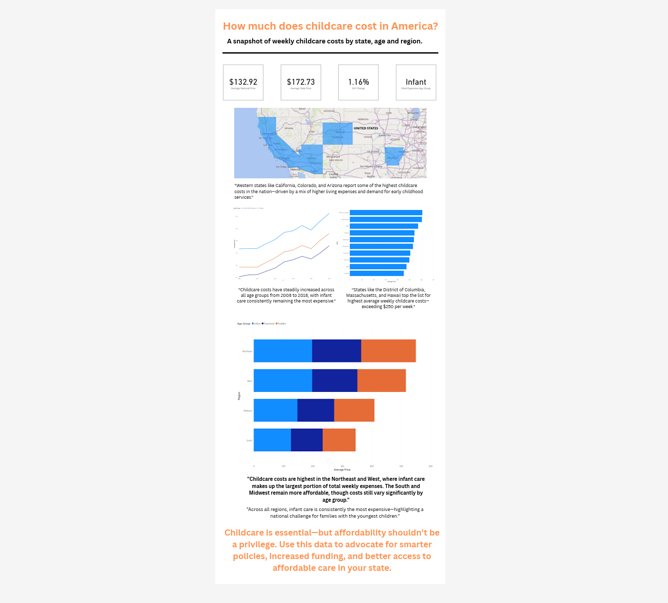
Medium 2: Infographic
The infographic serves as a one-page visual summary for working parents and general public audiences. It highlights key takeaways such as which states are most expensive, how costs have changed over time, and the cost gap between infant and preschool care. It uses bold icons, large fonts, and a clean layout to convey insights quickly and visually.

Slide 4
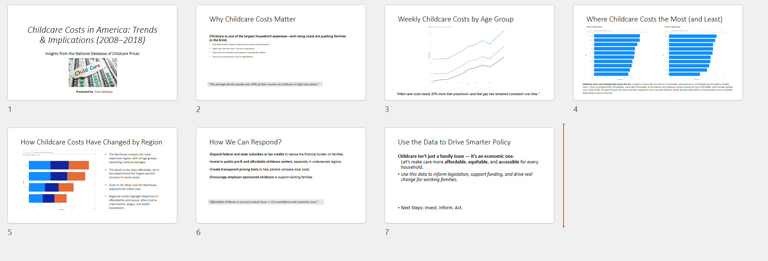
Medium 3: PowerPoint Presentation/Policy Brief Slide Deck
This presentation is intended for legislators and nonprofit decision-makers. The slide are data-driven but concise, with minimal text and a focus on actionable insights. The slide deck includes a brief introduction, 3 visuals (charts), and closing recommendations for how policymakers could respond to rising costs and affordability gaps.

